Slide 1
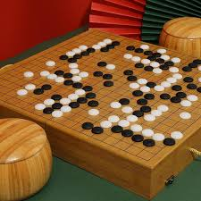
NabGo
Group 13 - Cameron Dugan, Josh Gifford, Wilder Scott

Slide 2
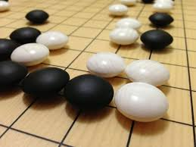
Overview
NabGo is a web-based tool intended to enhance the user’s knowledge of the game of Go.
Target Audience: Beginner-level players
Primary Features
Object detection
Digital game board
Game analysis
Chat bot for game assistance
Specs
19x19 boards

Slide 3




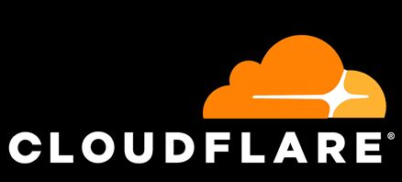

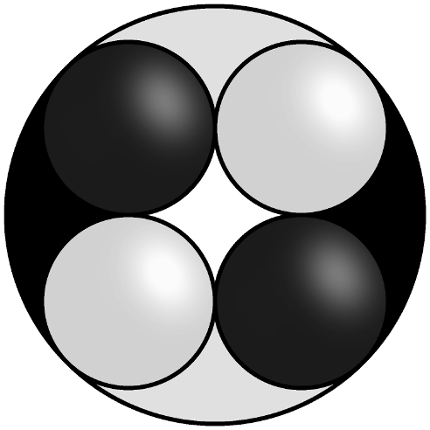
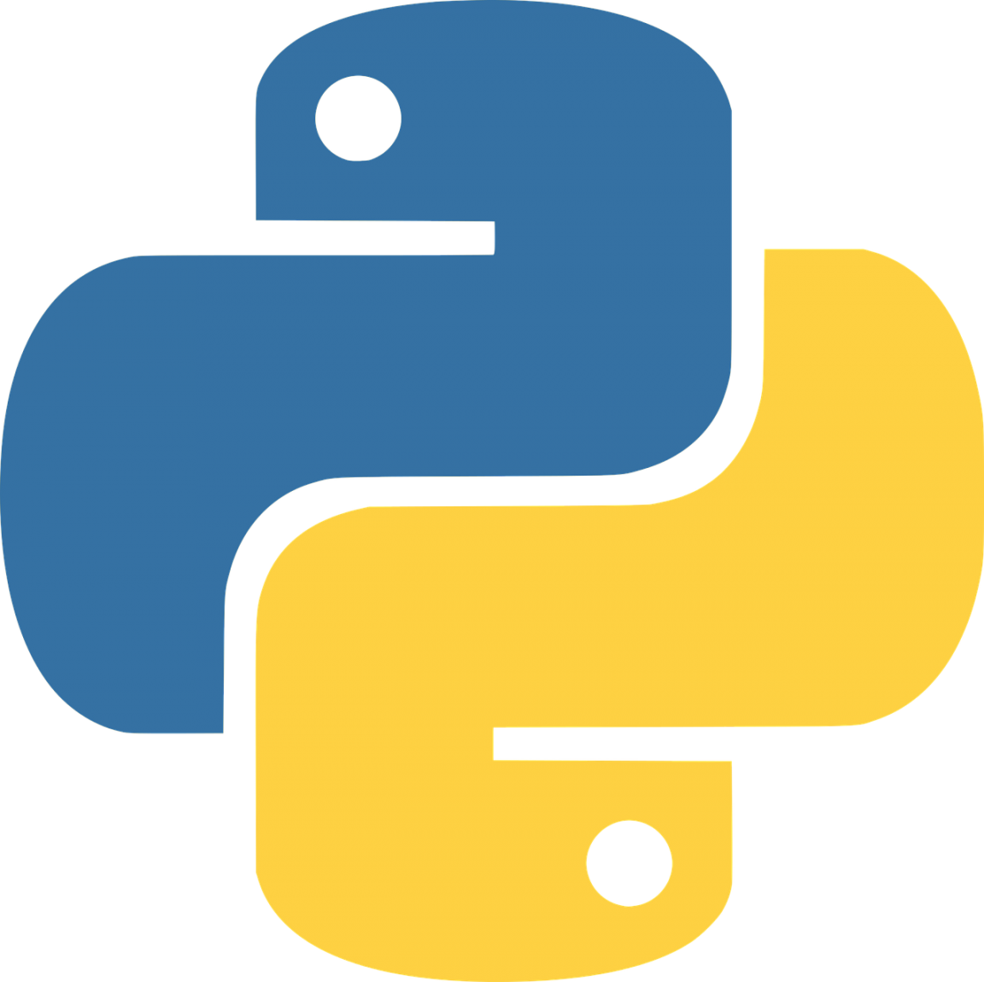

Technology Stack
Frontend
Frontend
Backend
Front End
HTML
CSS
JavaScript
Back End
Go
Python - Image prediction and KataGo
EdgeDB - database for logins
Libraries
Ultralytics (YOLOv8n) - object detection
KataGo - analysis engine
Ollama Llama3
Hosting
Login server: self-hosted
Back end: hosted on premises at Wentworth
Domain
nabgo.us

Slide 4
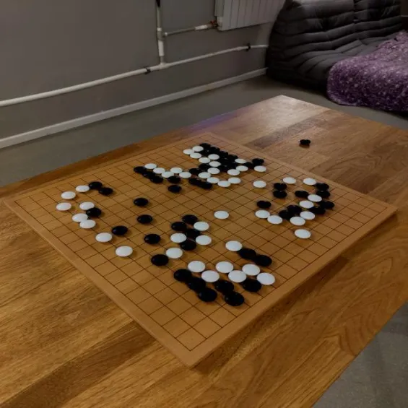
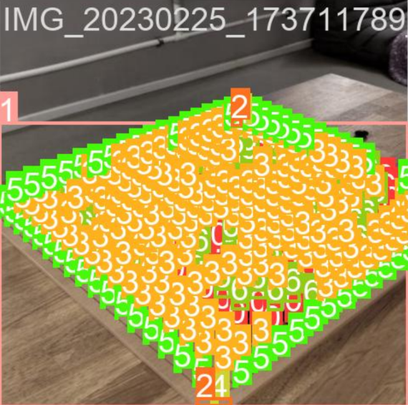
Feature 1: “Go Vision” and Object Detection
User uploads image of Go board
Machine learning model determines current game state
Model: YOLOv8n CNN (object detection)
Train model and save ONNX file
Python script to call prediction
Notes:
Train model and save as ONNX file

Slide 5
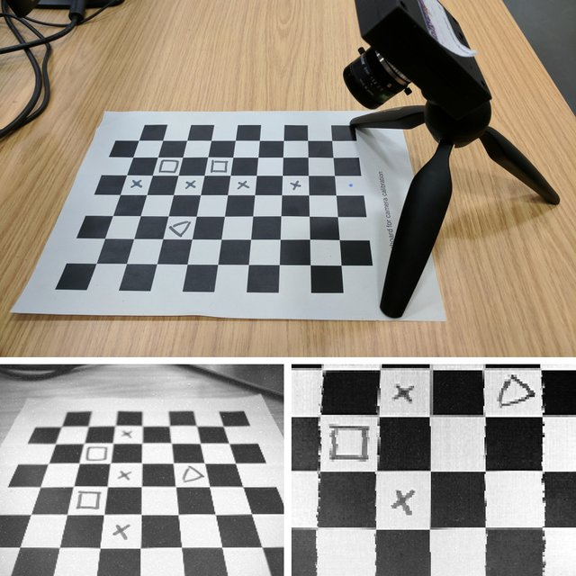
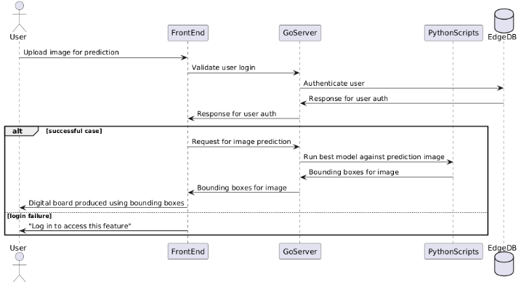
Feature 2: Produce Digital Version of Board
Find Board Corners (Model + Estimation)
Adjust to Point of View
Find Centers of all predicted pieces
Lock each center into a space to put it in

Slide 6
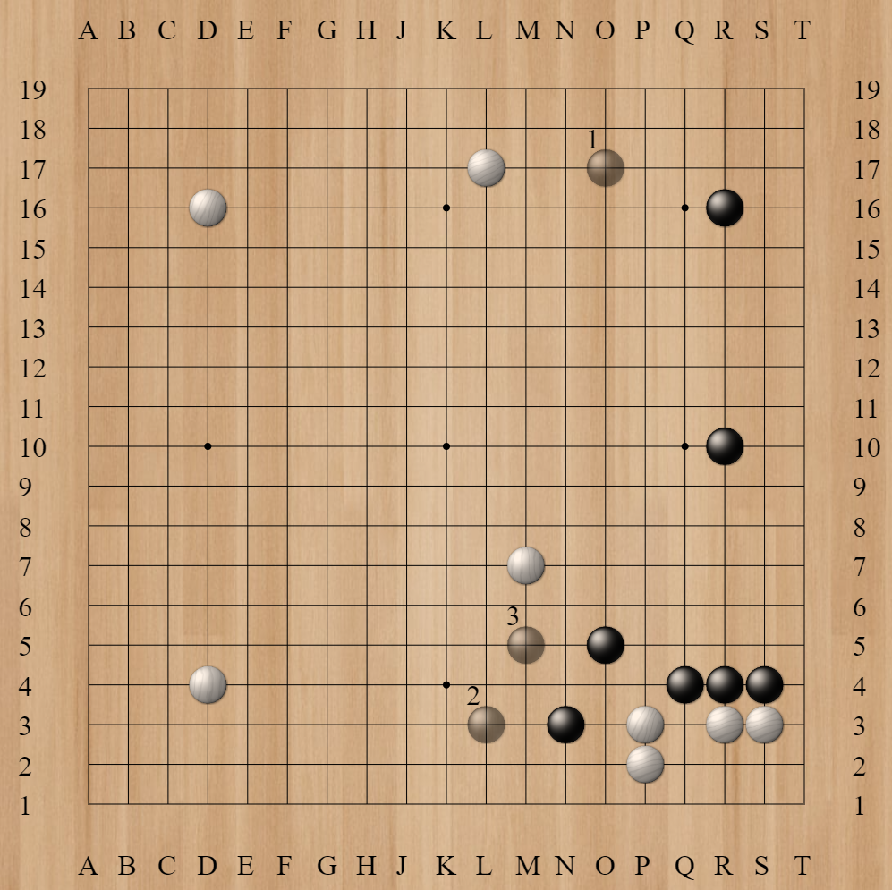
Feature 3: Game Analysis
2 options provided for game analysis
Copy SGF
For use on external Go websites (such as online-go.com)
KataGo
AI trained to play Go (https://github.com/lightvector/KataGo)
Includes analysis engine (can analyze over 600 moves/min)
Python script used to run engine based on current board state
Display win probability and current score
Show user 3 highest recommended moves
Notes:
SGF Library: rooklift

Slide 7
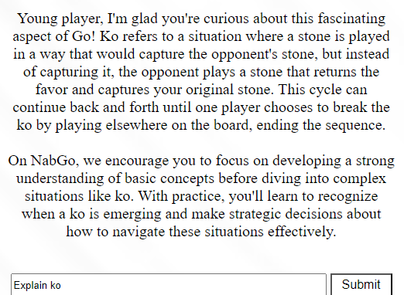
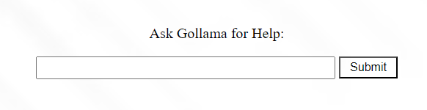
Feature 4: Gollama Chat Bot
Chat bot to answer user questions about Go
Implemented using Llama3
User can ask questions about game rules, strategies, etc.

Slide 8
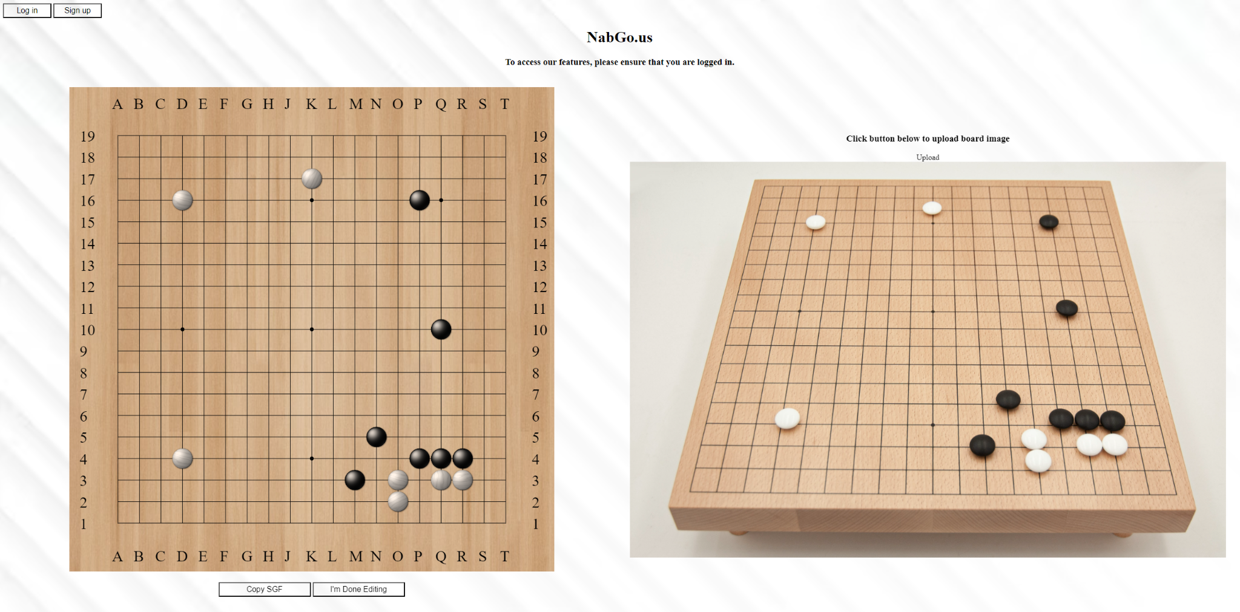
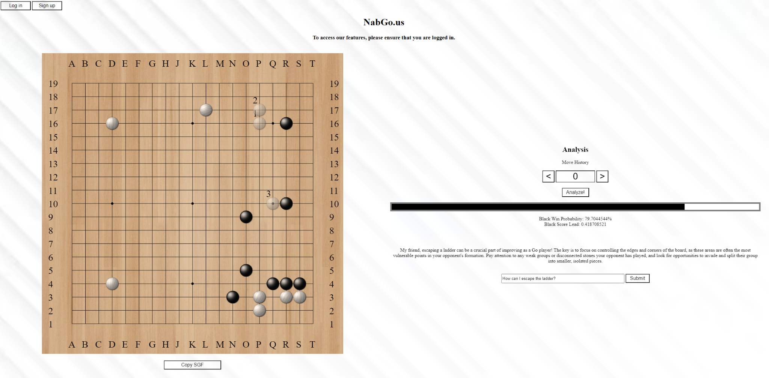
Front End
Implemented using HTML/CSS/JavaScript
Image Upload Interface
Digital Game Board
Editable to remove any inaccuracies from prediction
Once user confirms board, analysis and Gollama panels will appear

Slide 9
Works Cited
Hegemon, & jac. (2011, November 1). How do I check if a cookie exists?. Stack Overflow.
https://stackoverflow.com/questions/5968196/how-do-i-check-if-a-cookie-exists
Jocher, G., Chaurasia, A., & Qiu, J. (2023). Ultralytics YOLO (Version 8.0.0) [Computer
software]. https://github.com/ultralytics/ultralytics
Morgan, Jeffrey, et. al. (2024). Ollama (Version 3.1) [Computer software].
https://github.com/ollama/ollama
“Welcome to the Edgedb Docs!” Get Started | EdgeDB Docs, docs.edgedb.com/. Accessed
12 May 2024.
Wu, David. (2024). KataGo [Computer software]. https://github.com/lightvector/KataGo
Additional Resources and Acknowledgements
https://stackoverflow.com/
https://roboflow.com/
https://online-go.com/
https://docs.edgedb.com/
https://ai-sensei.com/
https://katagotraining.org/

Slide 10
Additional Resources
https://stackoverflow.com/
https://roboflow.com/
https://online-go.com/
https://docs.edgedb.com/
https://ai-sensei.com/
https://katagotraining.org/

